Slide 1

Home Credit Indonesia Data Scientist
dimas firmansyah https://github.com/DimsFrmnsyh/Home-Credit-Intern

Slide 2
Project Obejctive
Identify characteristics of potential clients who will have difficulty repaying loans.
Predict client’s repayment abilities.

Slide 3
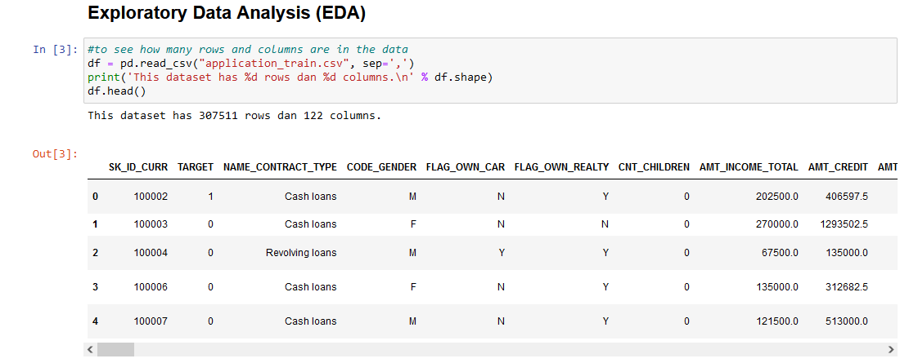
Dataset
The dataset used is: application_train.csv application_train.csv is a file that contains customer data.

Slide 4
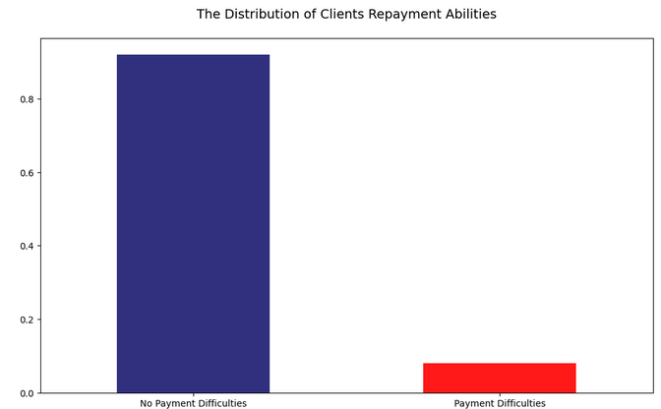
Insights
There are about 91% loans which is equal to about 282K with TARGET = 0, which indicates that client did not had any problems in repaying the loan in given time. While only 9% of the total loans (about 24K applicants) in this dataset involved the clients having problems in repaying the loan.

Slide 5
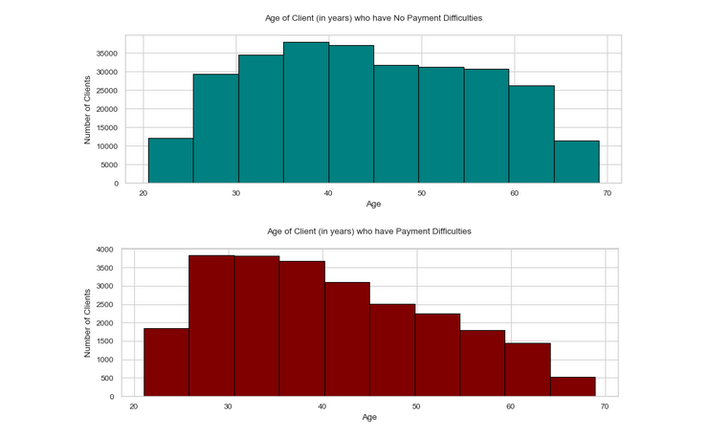
Clients who have no payment difficulties are client the range of 35-45 years. While clients who have payment difficulties are client the range of 25-35 years.
Most number of clients who apply for loans are in the range of 35-40 years, followed by clients in the range of 40-45 years. Meanwhile, the number of applicants for clients aged <25 or age >65 is very low.

Slide 6
Conclusion :
Clients who do not experience payment difficulties are clients with an age range of 35-45 years. We can target those clients as priority.

Slide 7
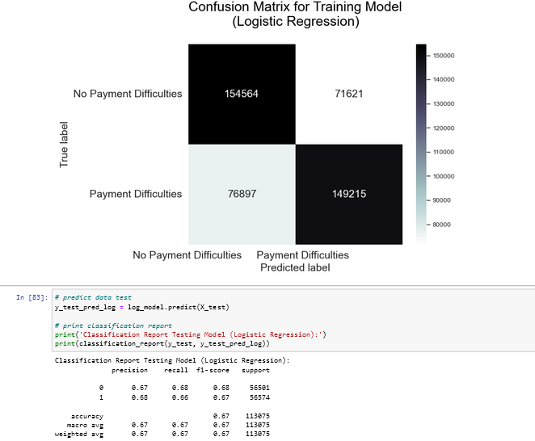
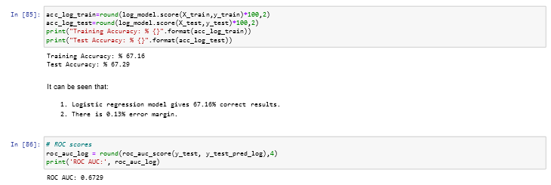
Logistic Regression

Slide 8
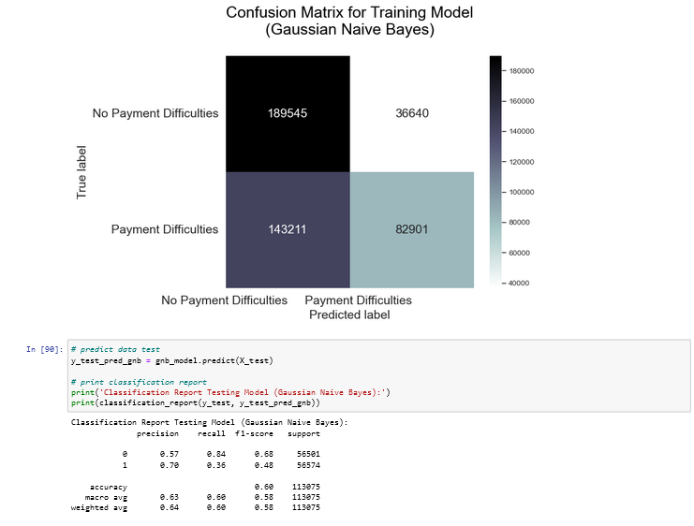
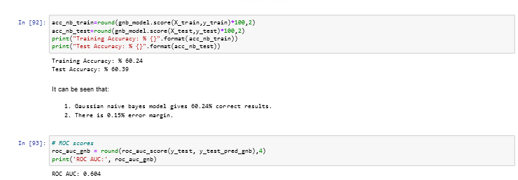
Gaussian Naive Bayes

Slide 9
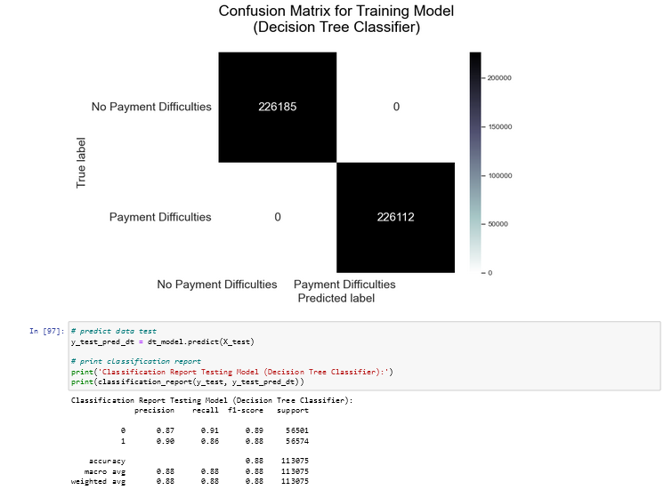
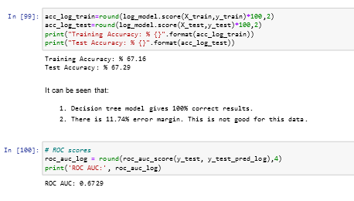
Decision Tree

Slide 10
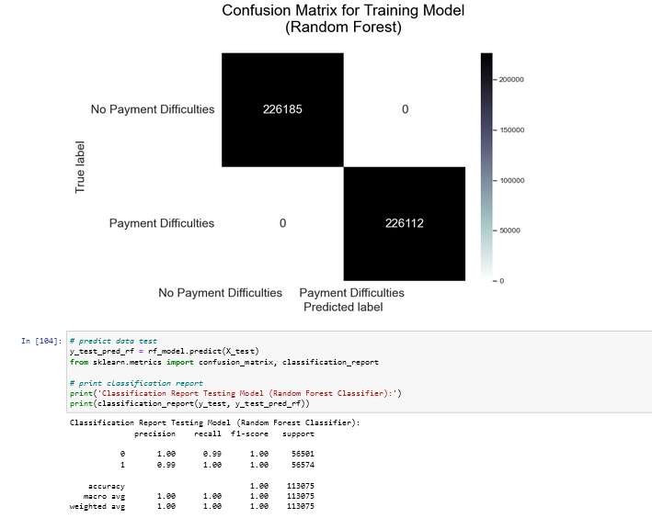
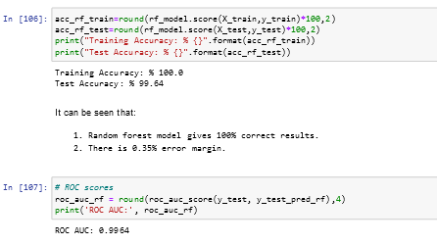
Random Forest

